Slide 1
MIS 547
Cloud Computing

Slide 2
Admin
Exam 1 is on Thursday
Assignment 5 is due Thursday at 3pm
No Quiz this week
It is a good idea to spend the weekend working on your group projects while you have a little free time!!!
Mid-course survey!!!

Slide 3
Lecture 9: Exam 1 Review

Slide 4
What is the Cloud

Slide 5
DEFINING CLOUD COMPUTING
NIST Characteristics of Cloud Computing
On-demand usage (self-service usage)
Ubiquitous* access
Multitenancy (resource pooling)
Elasticity
Measured Usage
Resiliency

Slide 6
DEFINING CLOUD COMPUTING
ON-DEMAND USAGE
A cloud consumer can autonomously access cloud-based IT resources, and self-provision these resources.
The customer doesn’t have to interact with the cloud provider.
They can access their cloud accounts through a web self-service portal to view their cloud services, monitor their usage, and provision and de-provision services.

Slide 7
DEFINING CLOUD COMPUTING
UBIQUITOUS ACCESS*
This is the ability for a cloud service to be widely accessible.
It requires support for a range of devices, transport protocols, interfaces, and security technologies.
In the case of public clouds, access is facilitated via the internet; in the case of private clouds, it’s facilitated through a LAN.

Slide 8
DEFINING CLOUD COMPUTING
MULTITENANCY
Multiple customers can share physical resources using a multi-tenant model.
This model assigns and reassigns physical and virtual resources based on demand.
Multi-tenancy allows customers to share the same infrastructure while maintaining privacy and security.
A cloud provider pools its IT resources to serve multiple customers by using multitenancy models that rely on the use of virtualization technologies.

Slide 9
DEFINING CLOUD COMPUTING
ELASTICITY
The automated ability of a cloud to scale resources as needed in response to runtime conditions or as predetermined by the cloud consumer or cloud provider.

Slide 10
DEFINING CLOUD COMPUTING
MEASURED USAGE
The cloud provider can charge a cloud consumer only for the resources they use and/or for the timeframe during which access to the resource was granted.
Measured usage can apply to billing, but also to general monitoring of resources and usage reporting.

Slide 11
Defining Cloud Computing
RESILLIENCY
A form of failover that distributes redundant implementations of IT resources across physical locations.
This can also refer to the overall ability of a service to recover quickly from any disruption, measured by how fast servers, databases, and networks restart and recover after damage.

Slide 12






Software as a service
Managed by a service provider
Consumers don’t worry about the underlying infrastructure, maintenance, or management
End-user applications where users only think about how to use and benefit from the product or service

Slide 13

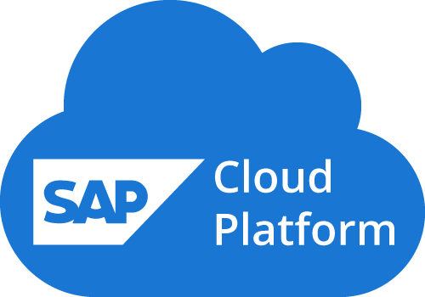
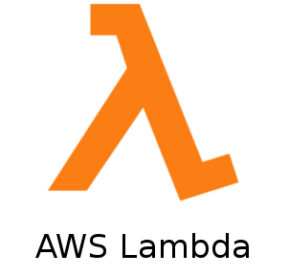

Platform as a service
An environment for engineers to create and deploy applications
Devs don’t worry about the backend infrastructure
Devs don’t configure or manage servers, DBs, datacenters, etc.
PaaS gives more control than SaaS
Notes:
. WordPress functions as PaaS when develoeprs get involved to build different features and functions into the blog.

Slide 14

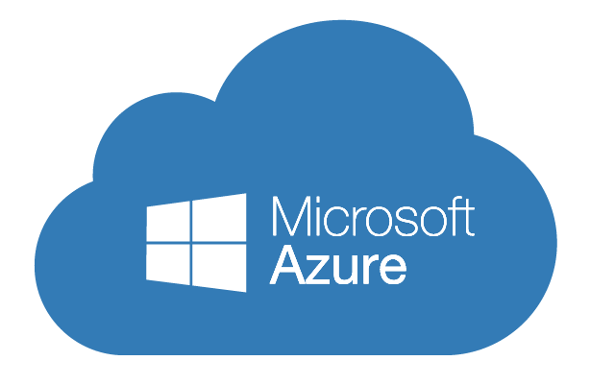
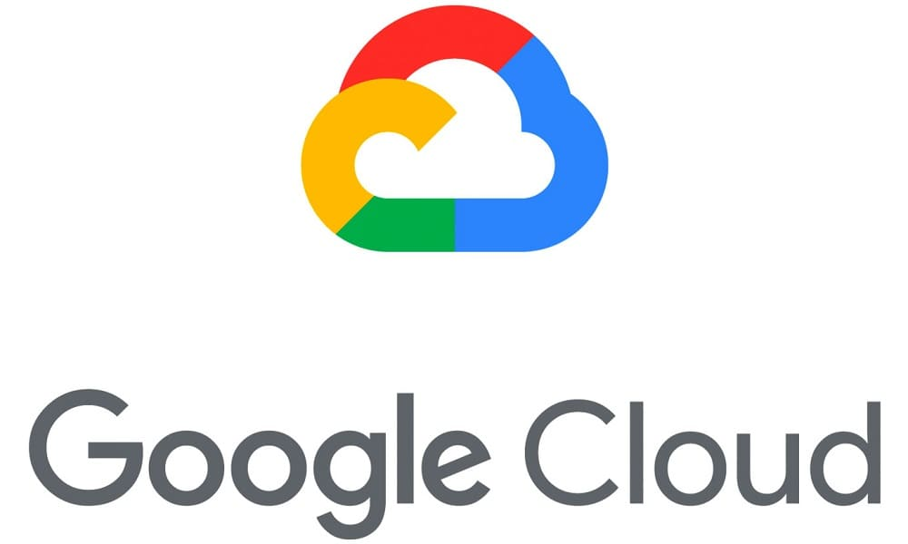
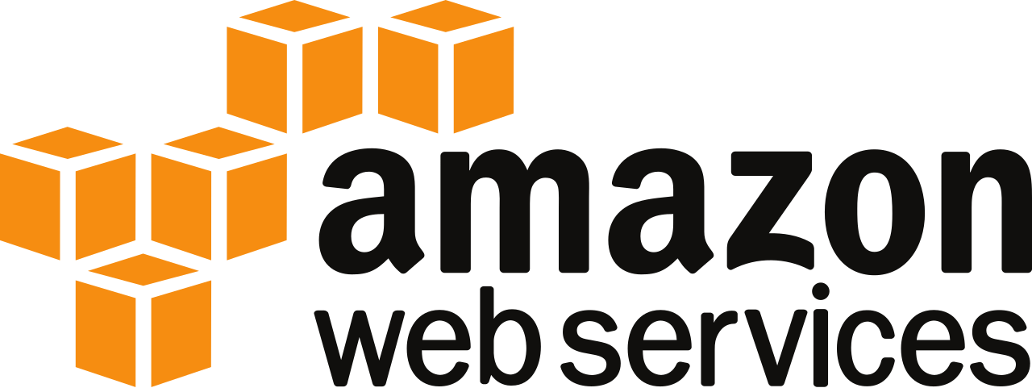
Infrastructure as a service
IaaS == physical/virtual IT infrastructure that a CSP offers
Configure, customize, and maintain a virtual version of your server room/ IT infrastructure
Compute, storage, networking
Requires more engineering than SaaS/PaaS
Most flexibility and customizability

Slide 15
Defining Cloud Computing: Cloud deployment models
Public Cloud
Hybrid
Private cloud
Multi-cloud
Deployment:
The process of setting up computer and network systems so they are ready for use.
The key difference in deployment models is how much control you have over the system.

Slide 16




Public Cloud
Public Cloud Service Provider
Servers
Databases
Enterprise A
Enterprise A Network
Notes:
First up, public cloud. These are you main CSPs, your AWS, Azure, GCP, DigitalOcean, Linode, etc. Basically all parts of the application or infrastructure are deployed in publicly accessible cloud environments owned by a third-party cloud provider. The cloud provider is responsible for the creation and maintenance of the public cloud and its IT resources. When we talk about cloud or cloud native deployments, it generally means that each piece of the application is deployed or lives in the cloud; the application and data were either created ‘in’ the cloud or migrated to the cloud from some existing physical infrastructure. Then users access the cloud via the internet

Slide 17


Public Cloud
Enterprise B
Public Cloud Service Provider
Enterprise B Network
Enterprise C
Enterprise A
Enterprise C Network
Enterprise A Network

Slide 18

Private Cloud
Private Cloud
Servers
Databases
Enterprise
Enterprise network extended via VPN*
Notes:
Next is the private cloud, which is sometimes also kind of called “on-prem” but not always. Private cloud deployments can literally be on the premises or they can be hosted offsite; it’s really just the fact that we’re also utilizing virtualization and resource management tools offered by cloud computing. So companies utilizing private cloud deployments may still have their physical server rooms and data centers, which means you don’t get all of the benefits of cloud computing but enough benefits exist that it’s one of the core cloud computing deployment types. One benefit could be that the risk of security compromises could be reduced because private cloud deployments allow an organization to fully control and maintain their own networks for the infrastructure, so no part of the infrastructure hits the public internet.
Other orgs may prefer to keep their data in a private cloud for security reasons but still want virtualization and app management resources to increase resource utilization. Private cloud deployments can be a way to get some of the benefits of cloud computing but still keeps legacy IT infrastrcutre intact. And the actual administration of the cloud environments can be carried out by internal staff or it can be outsourced.

Slide 19
Hybrid Cloud
Public Cloud Service Provider
Private Cloud
Enterprise Network
Notes:
Hybrid cloud deployments can be really useful for security reasons, and also for latency reasons. When you’re dealing with extremely large amounts of data, the latency can be noticeable and frustrating for your end users. Any latency can be problematic for day-to-day operations. So hybrid deployments can connect cloud-based infrastructure with existing resources that reside locally, like desktops or servers that live onsite. They can also connect with your private cloud resources. There are a few reasons for using hybrid cloud: you can control costs, you can control how well parts of your infrastructure are managed and secured, you reduce your dependence on another company like AWS, and there are also benefits when it comes to compliance issues, particularly around data and data privacy.
Hybrid cloud use cases generally start from existing on-prem infrastructure; sometimes you need public cloud infrastrcutre to handle bursty traffic during high demand. Sometimes you just need to keep your data in a private cloud but want to utilize the resources for your application in a public cloud.

Slide 20


Public Cloud B
MULTI Cloud
Public Cloud A
Public Cloud C
Enterprise
Notes:
And last, we have multicloud: this entails using two or more public clouds for your workloads. You can replicate the same workload on multiple clouds for higher availability, in case one provider goes bankrupt or has an outage. You can split workloads across multiple clouds; there can be a considerable difference between clouds when it comes to specific tasks and services. Maybe you want to use AWS for web apps, but use GCP for big data processing and analytics for your engineering team; and then for your internal enterprise data you want to use Azure instead of dealing with on-prem licensing for your office subscriptions. Basically with multicloud you pick and choose the best features from each cloud provider.
Mergers and acquisitions can sometimes lead to multicloud deployments; company A acquires company B, and company B’s enterprise productivity tools are all google workspace but company A’s tooling is all Microsoft 365, or company A has their applications and data in GCP but company B is using Linode. Whatever the use case, multicloud is challenging. You’re dealing with multiple different environments and your IT and devops teams have to manage them. Each cloud provider is going to have their own APIs and services. There are distinct certifications for each cloud, right? So some companies end up having dedicated teams for each cloud.
Migrations aren’t easy either, even for cloud-native applications, which are supposed to seamlessly transition between platforms. You sometimes have to re-architect, and the challenges involved in that rearchitecting can lead to vendor lock-in. There are tools and design patterns that we can use to limit the headache of migrating between clouds, and we’ll discuss those throughout the semester.

Slide 21

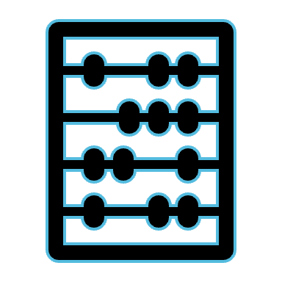




Six Advantages of Cloud Computing
Trade capital expense for variable expense
Benefit from massive economies of scale
Stop guessing capacity
Increase speed and agility
Stop spending money running data centers
Go global in minutes

Slide 22
What is an Operating System?
Memory mgmt
Interrupt handling
Talking with I/O devices
Managing files
Network stack mgmt
A collection of software that runs on your computer and runs all the “basic” stuff.
Abstracts away the different hardware components through an Application Programming Interface (API)

Slide 23
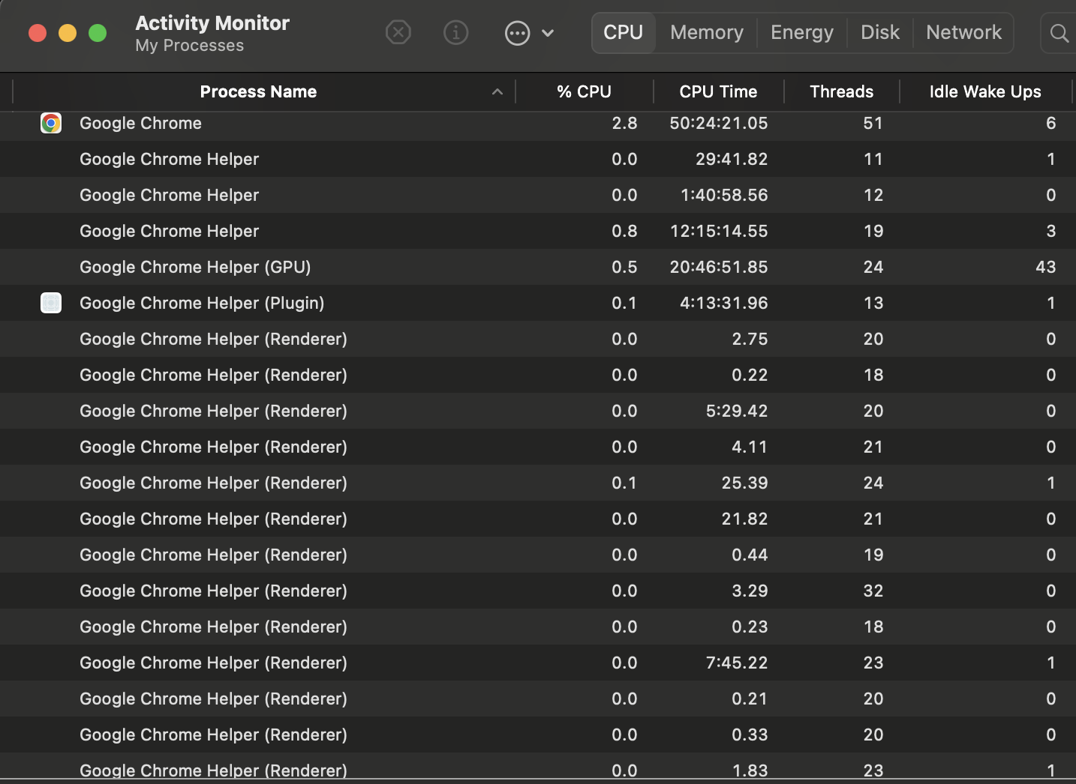
What is a Process?
A computer program is a passive collection of instructions typically stored in a file on disk.
A process is the execution of those instructions after being loaded from the disk into memory.
Several processes may be associated with the same program

Slide 24
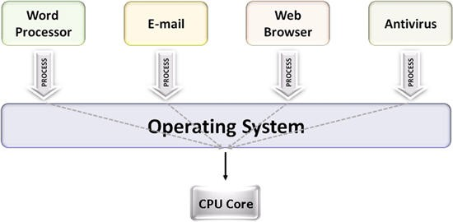
Multitasking
Multitasking is a method to allow multiple processes to share processors and other system resources.
Each CPU (core) executes a single process at a time.
Multitasking allows each processor to switch between tasks that are being executed without having to wait for each task to finish (preemption).
Source: NI Multicore Programming Fundamentals

Slide 25
Processes vs. Threads
Processes are executed by one or more threads
A thread is the smallest sequence of programmed instructions that can be managed independently by an OS scheduler.
The multiple threads of a given process may be executed concurrently (via multithreading capabilities), sharing resources such as memory, while different processes do not share these resources.
The threads of a process share its executable code and the values of its dynamically allocated variables and non-thread-local global variables at any given time.

Slide 26
Processes vs. Services
A service provides a set of coherent and related functions that can be reused and integrated into bigger and more complex applications. The term service is a general abstraction that encompasses several different implementations using different technologies and protocols.
A service is software that:
performs automated tasks
responds to hardware events
listens for data requests from other software
In a user’s OS, these services are often loaded automatically at startup, and run in the background, without user interaction.
Many services are loaded to accomplish different functions. They respond to user keyboard shortcuts, index and optimize the file system, and communicate with other devices on the local network.

Slide 27
Operating system Kernel
The core of the operating system.
When you boot up your computer, the instruction pointer starts at a program somewhere. That program is the kernel
The kernel has near full access to your computer’s memory, peripherals, and other resources, and facilitates running software installed on your computer
These are Userland programs
Linux is just a kernel and needs lots of userland software like shells and display servers to be usable.
The kernel in macOS is called XNU (”X is Not Unix”) and is Unix-like
The modern Windows kernel is the NT kernel

Slide 28

What is Linux?
Linux is the most widely used operating system in the world
Free and open source
Linux kernel:
The set of syscalls and device drivers that are provided as part of your Linux OS
Linux distributions (distros)
Concrete bundling of kernel and related components, including package management, file system layout, shell, etc. all preselected for you

Slide 29
Process IDs
Recall that a process is a program in memory that has all the necessary resources available to run, such as CPU and memory
Linux identifies a process using its process ID, or PID
PID 1 is reserved for the root of the user space process tree.

Slide 30
NaMESPACES
There can be multiple processes with the same PID, in different contexts called namespaces
This happens in containerized setups
e.g., when you’re running your app in Docker or Kubernetes
Part of the illusion of having multiple users or processes running in parallel is the restricted visibility into resources
The way to provide a local view on resources in Linux is via namespaces

Slide 31
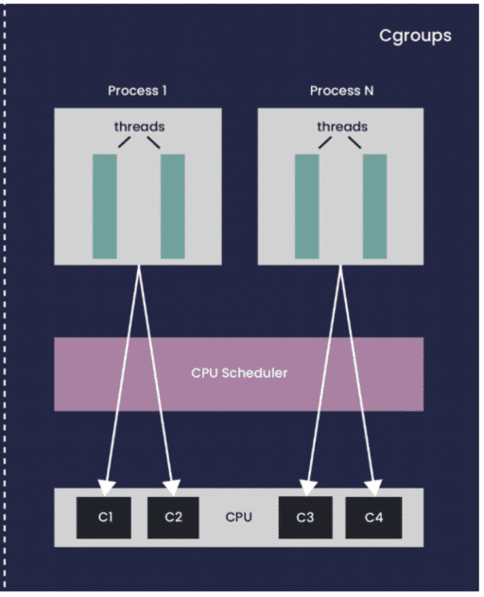
PROCESS Isolation
Process isolation can do many things, but one example is restricting memory consumption so that one process cannot starve other processes.
For example, we give your app 1 GB of RAM to use- if it uses more, it gets out-of-memory error and is killed.
cgroups are the mechanism that provides isolation.
A fully isolated environment gives the appearance that the app is entirely on its own.

Slide 32
Virtualization & Hypervisors

Slide 33
Types of Hypervisors
Type 2 Hypervisor
The kind of hypervisor we’ve been describing is known as a Type 2 hypervisor
A type 2 hypervisor is installed on top of the host operating system.
Notes:
When you’re virtualizing your laptop’s resources by installing a hypervisor on top of your operating system you’re using a Type 2 hypervisor.
In this case, we’re going from hardware
to host OS
to hypervisor
to guest OS.
Type 2 HVs are usually used on personal computers.

Slide 34
Types of Hypervisors
Type 1 Hypervisor
Type 2 Hypervisor
Notes:
In Type 1 hypervisors, we’re going from the hardware
directly to the hypervisor
to the guest OS.

Slide 35
Types of Hypervisors
Type 1 Hypervisor
“Bare metal” HV
Used in cloud computing to virtualize server resources
VMs run in their own isolated environment
As a cloud customer, your VM is sharing hardware with other customers
Multitenancy
Notes:
These are called “bare metal” hypervisors. They control hardware resources on behalf of the guest Oss, and you can install any OS on top of it.
This type of HV is used for servers,
it’s what cloud service providers use to virtualize all of our resources for our customers.

Slide 36
Common Type 1 Hypervisors
HyperV
vSphere
KVM
Microsoft
VMWare
Kernel-based VM
Open source
Linux
Often used in private cloud
Notes:
HyperV
Enbaled after a Windows OS install, and accessed through Windows OS
But when you enable hyperV, it inserts itself between the hardware and the OS, the OS that you see is essentially a VM running on the HyperV platform
vSphere
VMWare offers a type 1 hypervisor called vSphere, it’s widely used within orgs to provide virtualization infrastructure and private cloud functionality
Use in public clouds is somewhat limited because of proprietary nature
KVM
Kernel-based VM, open-source Linux-based hypervisor. Uses a loadable kenable module named kvm.ko and a platform-specific model, either kvm-intel.ko or kvm-amd.ko. KVM supports a wide variety of Windows and Linux Oss for the guest OS
This is what DigitalOcean uses

Slide 37

Benefits
Type 1 Hypervisor
Efficient hardware resource usage
Users can choose how much CPU, memory, and storage they want because these resources can all be virtualized.
CSP can use up server resources by dividing the server into partitions, that are then used by the VMs.

Slide 38
Benefits, cont.
Abstracts the OS from the hardware!
When OS is installed directly on the hardware, the OS is tightly coupled to that hardware.
THE OLD DAYS: If a hardware component fails and you can’t replace the component (old, or not reparable) the entire machine is useless and everything is gone, the OS, applications, and app data
This is a single point of failure
With virtualization, your OS is portable
Create an image of the OS (including applications and data) and reuse it
The server and the software running on top of it are now independent!

Slide 39
High-Availability, Redundancy, Failover
Regions
Availability Zones
Scale sets
Availability sets

Slide 40
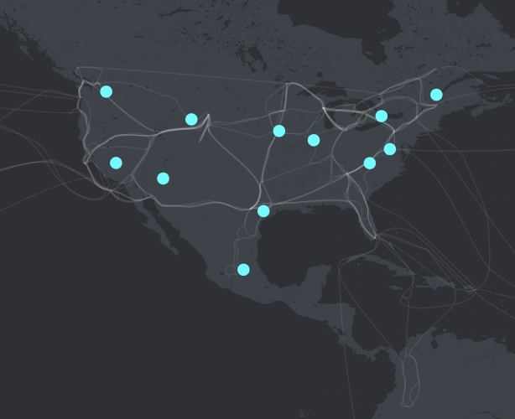
High-Availability, Redundancy, Failover
Regions
CSPs have datacenters all over the world.
You can select where you would like your services and data to reside by choosing a region.
Common: US-East, US-West
Choose a region closest to the highest usage of your resources
US Azure Regions
For an interactive exploration, visit https://datacenters.microsoft.com/globe/explore/

Slide 41
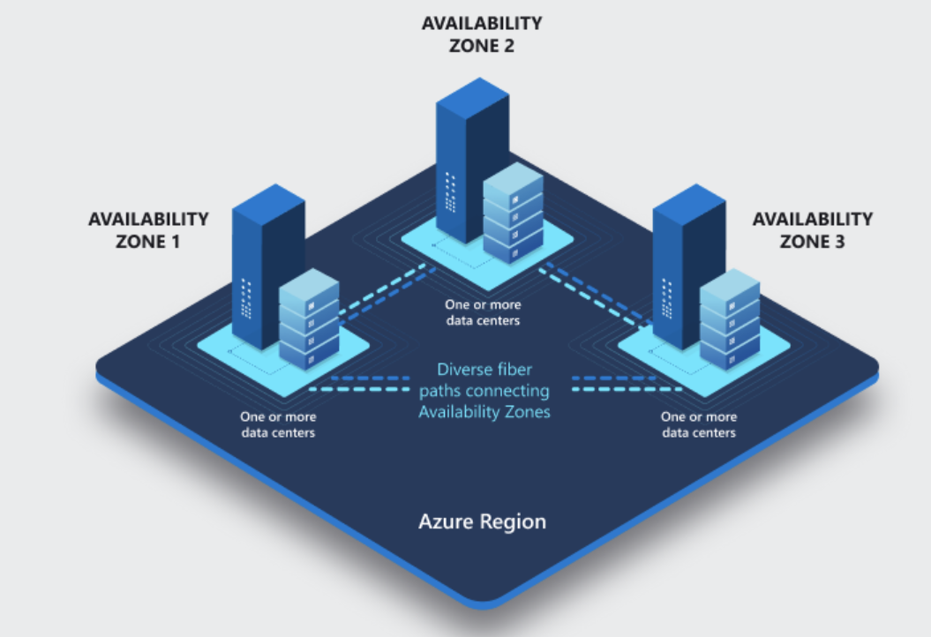
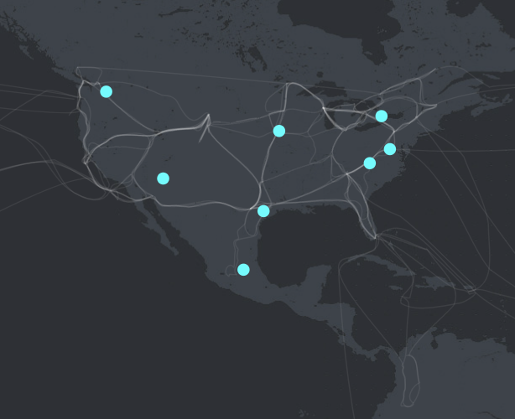
High-Availability, Redundancy, Failover
Availability Zones
Within-region redundant infrastructure
Protections in place in case one datacenter or AZ fails
For an interactive exploration, visit https://datacenters.microsoft.com/globe/explore/

Slide 42
High-Availability, Redundancy, Failover
Availability Zones
Not all Azure regions support AZs.
US Azure Regions that support availability Zones
For an interactive exploration, visit https://datacenters.microsoft.com/globe/explore/

Slide 43
High-Availability, Redundancy, Failover
Scale Sets:
Create a group of load-balanced VMs
Can be provisioned across AZs
Allows applications to scale in response to demand
High-availability of your application
If one VM isn’t available, traffic automatically routed to another available one
We will cover this in great detail in the second-half of the semester

Slide 44
High-Availability, Redundancy, Failover
Availability Sets:
Mitigates single point of failure risks
Automatically duplicate your VM across fault domains
Fault domains define groups of VMs that share the common power source and network switch

Slide 45
Virtual Machines

Slide 46

What is an image?
A portable file generated from the OS
Includes OS, applications, configuration, data
You can make copies of it, have backups, etc.
Snapshots
You can run this image on a different computer with a hypervisor
No longer dependent on any physical server
OS
Apps
Config
Data
VM
HV
Server

Slide 47
Creating a Virtual Machine: Types of VMS
Type | Description | Use cases
General purpose | Balances CPU-to-memory ratio | Testing, development, small DBs, low traffic web servers
Compute optimized | High CPU-to-memory ratio | Medium traffic web servers, network appliances, batch processes, application servers
Memory optimized | High memory-to-CPU ratio | Relational DBs, medium caches, in-memory analytics
Storage optimized | High disk throughput & IO | Big data, SQL, NoSQL DBs, data warehousing, large transactional DBs
GPU | Single or multiple GPUs | Heavy graphic rendering, video editing, model training & inferencing
HPC | Powerful CPU with high-throughput network | DNA sequencing, stock trading, IoT data, GPS

Slide 48
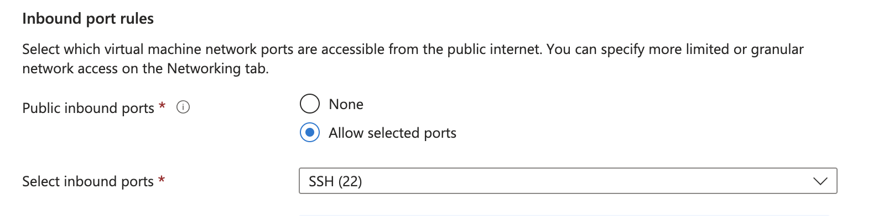
Creating a virtual Machine: Inbound Ports
By default, SSH uses port 22. You’ll need to make sure port 22 is open on your remote system or you won’t be able to connect to it!

Slide 49
Virtual Machines: Scaling Out vs Scaling UP
Scale up (vertical scaling)
Scale out (horizontal scaling)

Slide 50
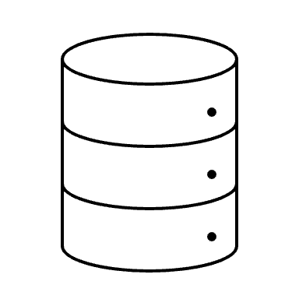

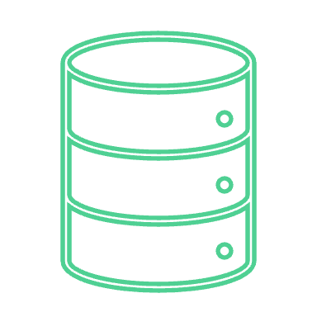
Virtual Machines, cont.
Server 1
Server 1
Maintenance can still be a challenge
Production server + small update to application
Have to rebuild an entire OS image + application to redeploy
Time consuming to build and regenerate
Configuration drift
Image
Server 2
Server 2
ad hoc change
Server 3
Server 3

Slide 51


Virtual Machines, Cont.
3 redundant VMs for high availability
Hypervisor
CPU required for each VM
OS
Services
Processes
Applications
Storage for each VM
Ubuntu → 3.4 GB
Python 3.12 → 170MB
pyenv → 14MB
Jupyter server → 4GB
Notebooks (up to 25MB)
Network for each VM
Network interface (NIC)
IP address for each VM- can get expensive

Slide 52
VM Limitations
Boot time
Size
Scaling up requires a new VM; scaling out might not be fast enough
More overhead, use more resources → limits the # of VMs that can run on a single host machine.

Slide 53
Containers!

Slide 54
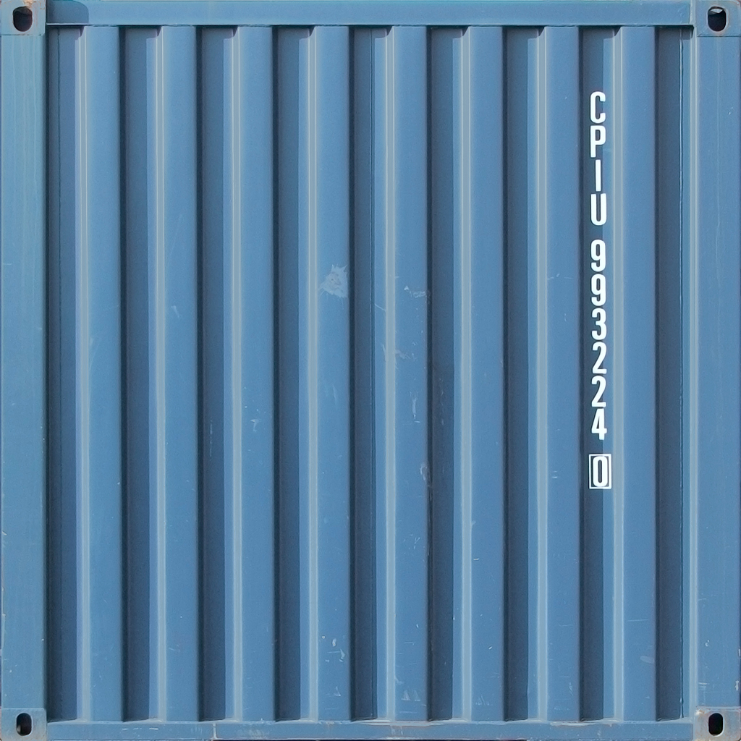
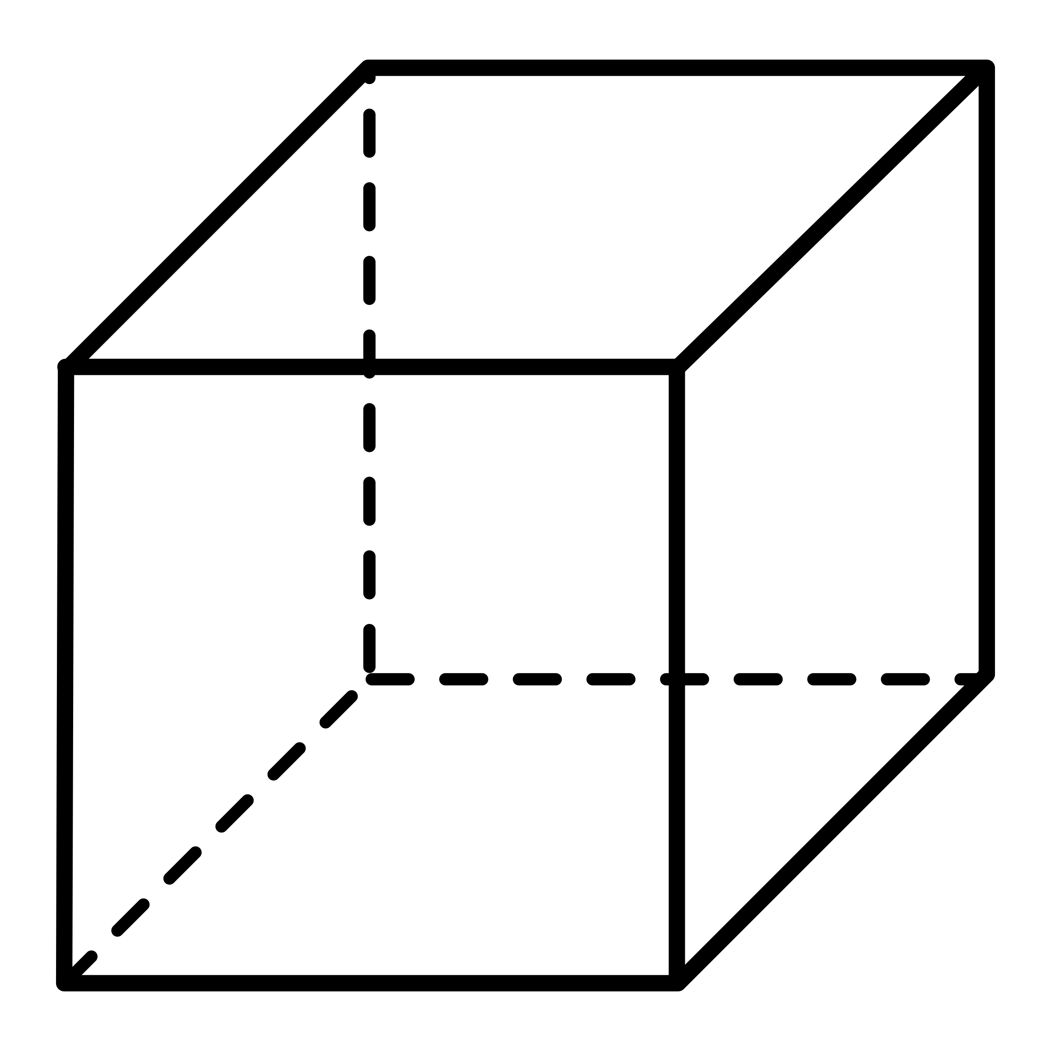
Containers
Containers are encapsulated, individually deployable components running as isolated instances on the same operating system with virtualization happening on the OS level.
A container is a sandboxed process running on a host machine that is isolated from all other processes running on that host machine.
Container A
Container B
Container C
Container Engine
Operating System

Slide 55

Containers
For modern applications, containers have become the default unit of deployment
They encapsulate the application code, its runtime, dependencies, system libraries,
Fast startup time → ideal for scale-out scenarios
app
runtime
dependencies
libraries

Slide 56
What are Containers?
Image
A container is a runnable instance of an image.
Can be run on local machine, virtual machines, deployed to the cloud.
Containers are portable and can run on any OS
Image needs to be built for a particular platform (e.g., x86, ARM)
Can be built for multi-platform using buildx, not sure if we’ll use it this semester
A container runs its own software, binaries, configurations, etc.

Slide 57
Why Do We need Containers?
Deterministic Deployment:
Application needs to work consistently on multiple platforms and different hardware
VM
Data center
Public and private clouds
Dev, test, prod

Slide 58
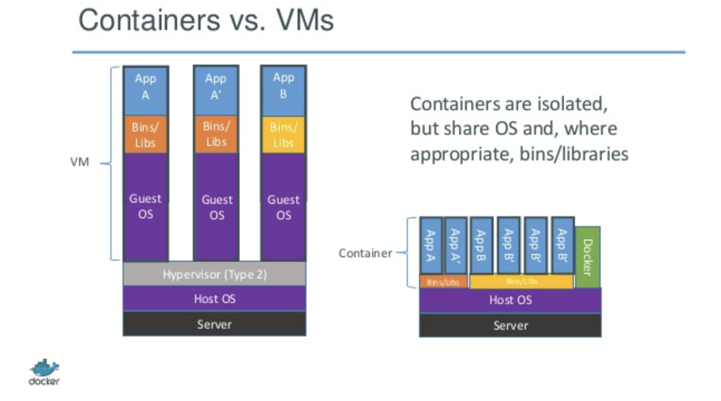
Containers vs Virtual machines
VMs are provisioned with hypervisors
Applications run inside a virtual machine on top of the guest OS
Containers
Containers run directly as processes on the host OS
No middle layers
Very light footprint → pack a higher number of containers than VMs on the same physical machine

Slide 59
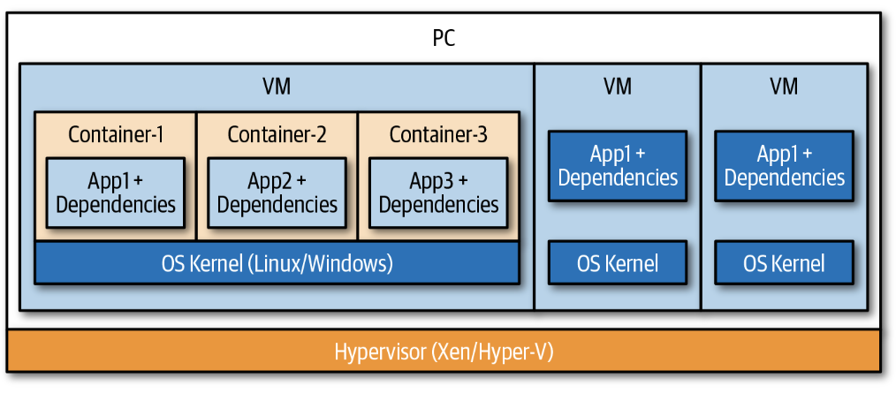
Containers vs virtual machines

Slide 60
Images
The blueprint for a container

Slide 61
Images and Containers
The box of our application code and its dependencies and libraries is called an image
A running instance of this box is called a container.
The image must contain everything needed to run an application: dependencies, configurations, scripts, binaries, etc.
The image also contains other configurations for the container, including environment variables, a default command to run, and other metadata.
A running container uses an isolated filesystem.

Slide 62
Container Registries
Specialized web applications that categorize and store repositories.
Tools that build, run, and manage containers need access to images; access is provided by referencing a registry.
Any environment using containers will need to use one or more registries

Slide 63
Container Registries
When we create our container image we start with a base image.
This image is pulled from a container registry.
Docker Hub
Private registries
Why might we use a private registry?
Development
Registry
image: latest
image: latest
image:v1
Testing/ Staging
image:v2
image:v2
Production
image:v2

Slide 64
Benefits of Using containers
Light footprint
Can be deployed within milliseconds
Flexible (can run on any computer, infrastructure, cloud environment)
Scaled up or down easily
Rich ecosystem
Use less memory and CPU than VMs running similar workloads
Increase productivity with reduced overhead
Portable and consistent

Slide 65
Cloud Storage

Slide 66
Comparing Storage Types
 | Object | Block | File
Storage method | Unstructured data in non-hierarchical buckets | Blocks of fixed size, reassembled on demand | File-level protocols and permissions
Storage capacity | Unlimited | Limited | Limited
Retrievability | Customizable | Data lookup table | More difficult
Metadata | Unlimited and customizable | Very little metadata | Limited metadata
Performance | Minimal latency | High performance, low latency, rapid data transfer | High performance for shared file access
Physical storage | Distributed across multiple nodes | Distributed across SSDs and HDDs | On-prem NAS or on top of physical block storage
Storage use cases | Application assets, logs, analytics, backups, video, audio, images, data archives, ML data sets, storage for serverless and microservice apps | Critical system data, database storage, mission critical application data, RAID volumes | User-level file storage and collaboration

Slide 67
Interfacing with Object Storage
Object storage is usually accessed via APIs
Software Development Kits (SDKs) let us interact with cloud API calls in our applications
boto3 is the Python SDK for AWS
boto3 allows Python developers to write software that makes use of services like S3 and Amazon EC2

Slide 68
Relational VS. Non-Relational DATABASES
Relational
Non-Relational
Stores data in tables
Need to define schema (structure of tables)
Structured data
ACID: Atomicity, consistency, isolation, durability
Stores data as key-value, JSON, nodes, vectors, etc.
Schema-less
More flexible
BASE: Basically available, soft-state, eventually consistent

Slide 69
Relational Vs. Non-Relational Database Performance
Relational
Non-Relational
Performance factors
Relies on disk subsystem
Use SSD, optimize the disk by configuring with RAID (Redundant array of independent disks) arrays
Need to optimize indexes, table structures, queries
Depends on network latency, hardware cluster size, calling application
Increase cluster size, minimize network latency, index and cache
Higher performance and scalability for specific use cases
Performance improvement
Performance
optimization

Slide 70
Recall: vertical and horizontal Scaling
 | Horizontal Scaling | Vertical Scaling
Description | Increase of decrease the number of nodes in a system to handle an increase or decrease in workload | Increase or decrease the resources of a single node in a system to handle increased or reduced workload
Example | Add or reduce the # of VMs in a cluster | Add or reduce the CPU or memory of VM
Workload Distribution | Workload is distributed across multiple nodes; parts of the workload resides on these different nodes | A single node handles the entire workload
Complexity | Higher | Lower
Downtime | No | Yes
Load balancing | Necessary to actively distribute workload across the multiple nodes | Not required in the single node
Implementation | Takes more time, expertise, and effort | Takes less time, expertise, and effort

Slide 71
Vertical Scaling
Pros
Cons
Less complex process communication
Less complicated maintenance
Less need for software changes
Higher possibility for downtime
Single point of failure
Upgrade limitations
Notes:
When a single node handles all the layers of your services, it won’t have to synchronize and communicate with other machines to work. Faster responses
Not only is maintenance cheaper but it’s less complex because of the number of nodes you will need to manage
Less need for software changes: you don’t need to refactor your software or change how the software works on a server or how it’s implemented
Unless you have a backup server that can handle the same ops and requests, you will need some considerable downtime to upgrade your machine
There’s also a limit to how much you can upgrade a machine. There are maximum thresholds for RAM, storage, and processing power.

Slide 72
Horizontal Scaling
Pros
Cons
Fewer periods of downtime
Increase resilience and fault tolerance
Increased performance
Increased complexity of maintenance and operations
Increased initial costs
Notes:
Add addt’l machines to your current pool. Eliminates the need to analyze which system specs you need to upgrade
Don’t have to switch the old machine off while you’re scaling

Slide 73
Scaling Relational Vs. Non-Relational Databases
Relational and non-relational databases have different considerations when scaling.
To scale SQL (relational) databases we must very carefully manage indices.
Recall the idea of database sharding from MIS531
In NoSQL databases, scaling can be handled in a very different way...

Slide 74
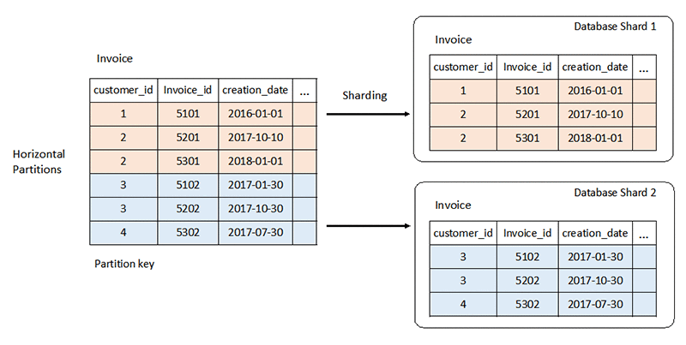
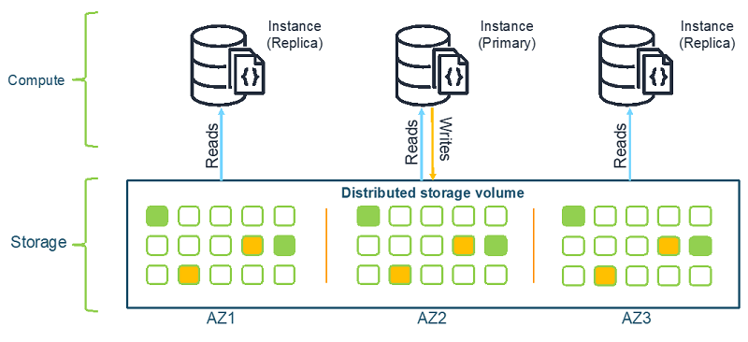
Scaling Databases
Relational
Non-Relational

Slide 75
Cloud Databases

Slide 76
Cloud Databases: Full Picture
SELF-MANAGED
(CLOUD) MANAGED
TRADITIONAL
CLOUD-NATIVE
SQL
NoSQL
SQL
NoSQL
MySQL
MongoDB
Azure SQL
CosmosDB (Azure)
SQL Server
Cassandra
Aurora (AWS)
DynamoDB (AWS)
Oracle
CouchDB
PostgreSQL
RDS (AWS)
BigTable, Firestore, Memorystore, (GCP)
Cloud Spanner (GCP)
MariaDB

Slide 77
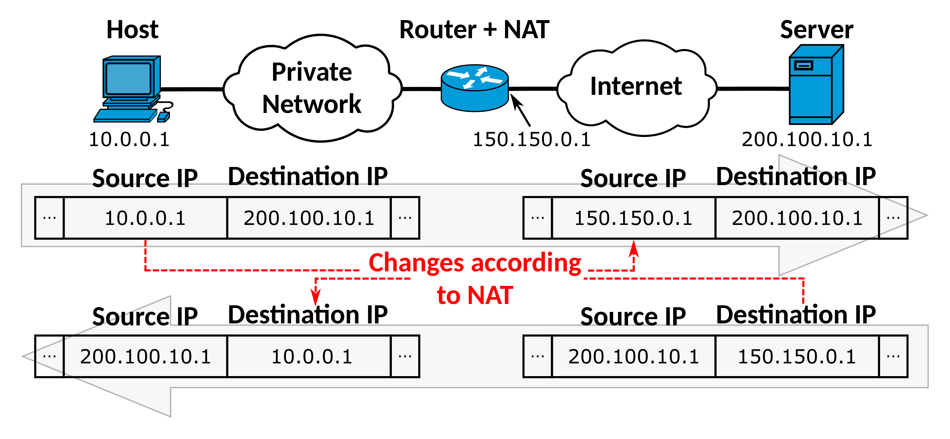
Network Address Translation (NAT)

Slide 78
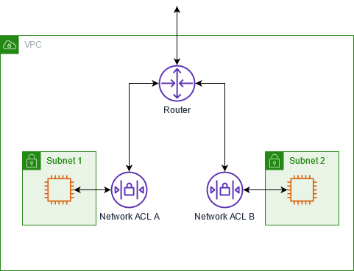
Network access control lists
NACLs are an optional software firewall that controls inbound and outbound traffic for each subnet within the VPC
Each NACL contains a set of inbound and outbound subnet traffic rules
A custom NACL can be associated with any subnet
A subnet can only be associated with one ACL
Source: AWS

Slide 79
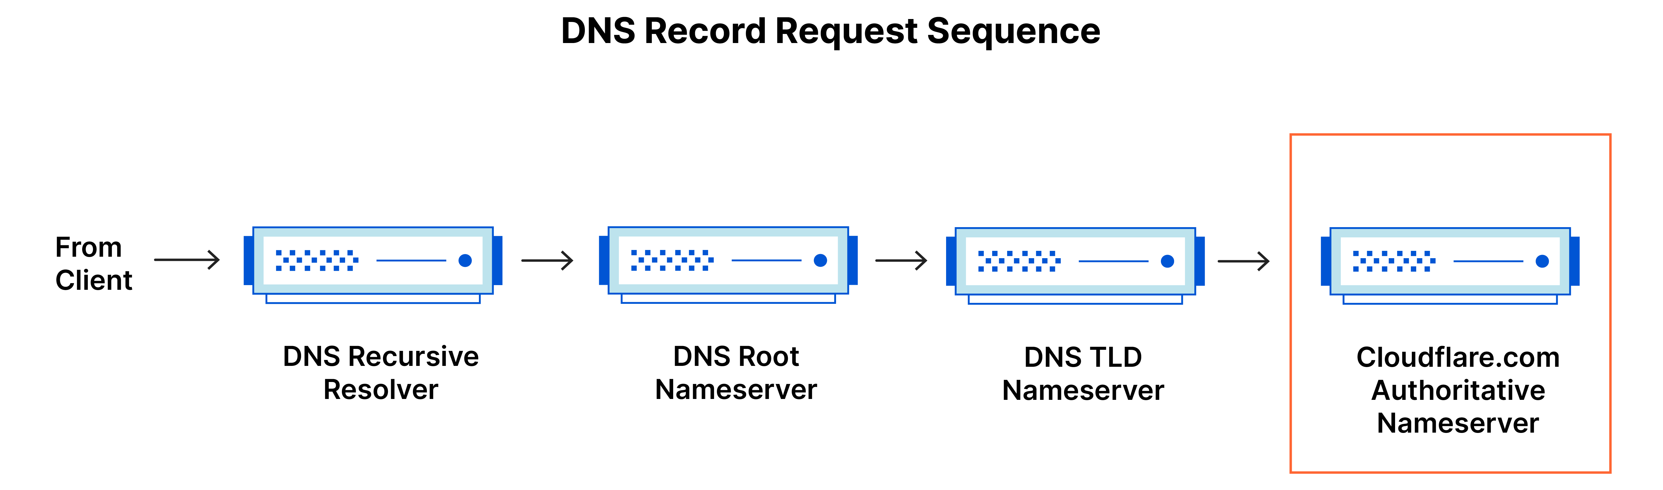
DNS Servers
DNS Recursor
Root nameserver
TLD nameserver
Authoritative nameserver
Acts as an intermediary who can get the DNS information. Receives queries from client, makes a series of requests to other DNS servers until it finds the record.
Can directly answer queries for records stored or cached within the root zone. Can also refer queries to the appropriate TLD server.
Hosts the last portion of a hostname (e.g. .com, .net, .gov, etc.)
Where the actual record mapping domain to IP address is kept

Slide 80
What is a Subnet
A subnet is a way of logically isolating resources within a VPC.
Subnets allow you to have more granular control over which resources can communicate with each other, and which resources are accessible from the public internet.
For example, you can ensure that your databases do not have a direct root to the public internet by placing your database in a private subnet.

Slide 81
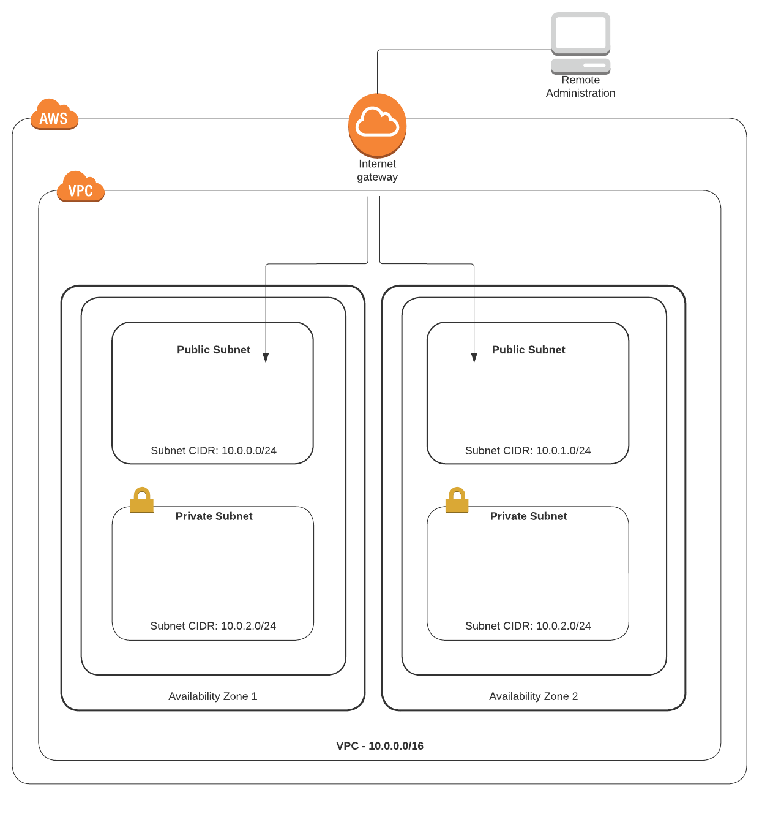
Subnetting in VPCs
Public subnets: For all resources that need to be reachable from the internet
Private subnets: For all resources that should not be reachable from the internet
Key differences:
A public subnet has a route to the internet
A private subnet does not

Slide 82
Subnetting in VPCs
Creating a VPC in AWS using the wizard gives four options:
1. VPC with a single public subnet
2. VPC with public and private subnets
3. VPC with public and private subnets and hardware VPN access
4. VPC with a private subnet only and hardware VPN access

Slide 83
Subnetting in VPCs
Subnet Schema | Why you might want it | Use cases
VPC with single public subnet | You want to run your instance in an isolated environment of AWS Cloud. However, you want to access those instances using the internet. | Simple test environment Public-facing software as a service app Design with multiple VPCs for controlling incoming traffic flow through a transit network
VPC with public and private subnets | You want to run your instance in an isolated environment of AWS. You want to access those instances using the internet. You also want to have an instance that can’t be accessed directly from the internet but that can be accessed from the public subnet. | Multi-tier application Public subnets would be utilized for NAT servers or additional public-facing services like load-balancing services Multiple private subnets could be created and used for hosting, web and app servers, database servers

Slide 84
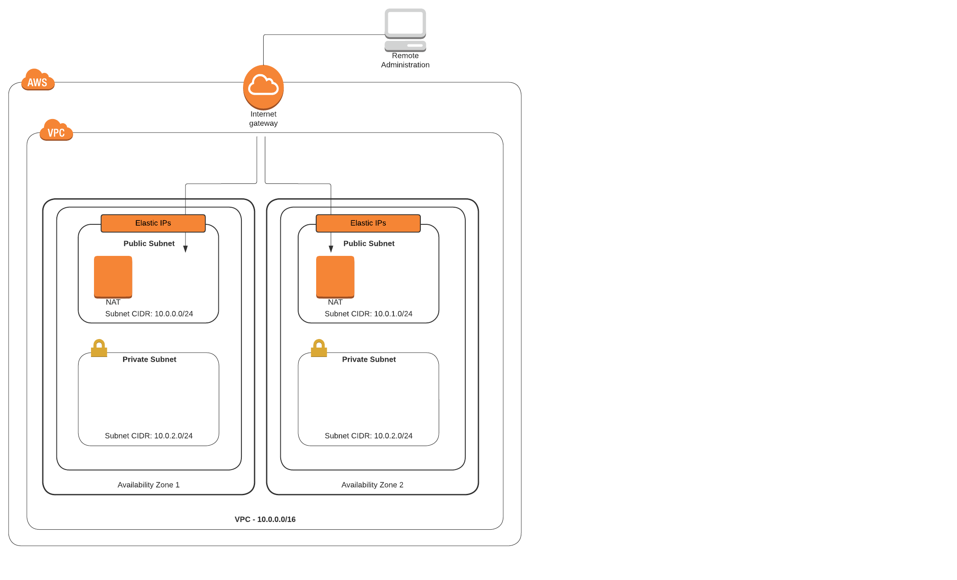
NAT Gateways
Always placed in a public subnet and configured with an Elastic IP address (static public IP address)
Elastic IP is for public communications, and the private IP is for the private communications with the private subnets.
NAT Gateways are created in each AZ and ensure the route tables in each private subnet point the EC2 instances to the correct gateway location

Slide 85
Elastic IP addresses
AWS-assigned public IP address is detached when an EC2 instance is turned off.
Once the instance is turned back on, AWS assigns a new public IP address.
If you need the same public IP address to persist, use an Elastic IP (EIP) address.
Public elastic IP address is a static IP address that after creation is assigned to your account at AWS.
If you turn your instance off and back on, the EIP is still assigned
If you don’t assign the EIP after you receive it, you’re still charged.

Slide 86
Elastic IP addresses
Each EC2 instance that receives a public IP address at AWS is also provided with an external DNS hostname.
The external DNS hostname is resolved to the public IP address of the EC2 instance when queries are external to AWS.

Slide 87
Cloud Networking

Slide 88
When to Use Elastic IP
NAT instances
Public-facing and private load balancers
NAT gateway services
Not needed for EC2 instances

Slide 89
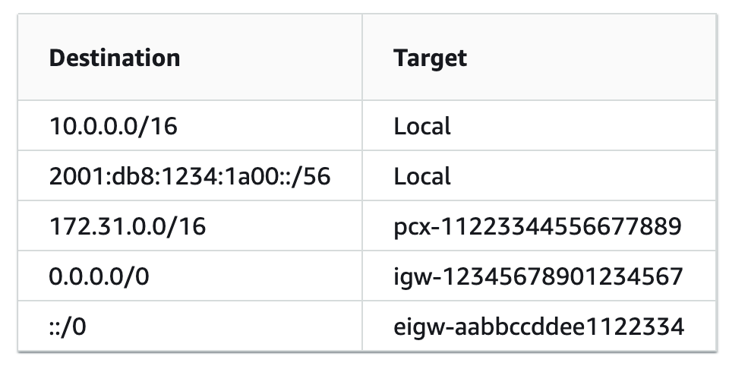
Route Tables
Public subnet route table
Public-facing infrastructure routing table:
ELB, NAT gateway services
Add a route for the IGW enabling public network traffic between network interfaces hosted on the public subnets and the attached internet gateway
Internet gateway routes are set with a destination route of 0.0.0.0/0 because the destination may be anywhere on the public internet.

Slide 90
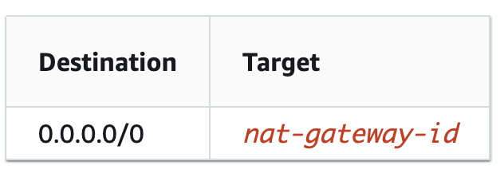
Route Tables
Private subnet:
Application and database tiers routing table
To enable EC2 instances on a private subnet to connect to the internet and receive updates, the NAT gateway service will be hosted on public subnets within each AZ.
Routes pointing to the NAT gateway service must be defined in the route table associated with the private subnets.

Slide 91
Internet Gateway (IGW)
Must attach an IGW to the VPC before traffic can flow to or from the internet
After creating the IGW, associate it with the desired VPC
Update the route tables to allow subnets to send their public traffic to the IGW
Default destination route assigned to an IGW is 0.0.0.0/0
Can limit to a specific IP range (company HQ, DC, etc.) or other EIP, BYOIP
NAT is performed on all outgoing public traffic

Slide 92


Load Balancers
Modern applications process millions of users simultaneously
High-traffic necessitates many redundant resource servers with duplicate data and software to serve the users
Load balancers distribute appropriate workloads/traffic/requests to redundant servers
myapp.com
Load Balancer
App Server 1
App Server 3
App Server 2

Slide 93
Why Use Load Balancing?
Availability
Scalability
Security
Performance

Slide 94



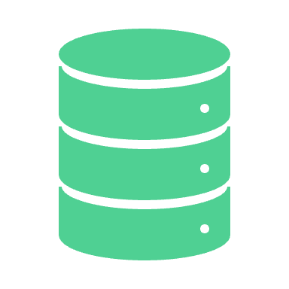


Load Balancing Benefits
Availability
myapp.com
Increase fault tolerance of systems by automatically detecting server problems and redirecting client traffic to available servers
Load Balancer
Run application server maintenance or upgrades without application downtime
Provide automatic disaster recovery to backup sites
App Server 1
App Server 3
App Server 2
Perform health checks and prevent issues that can cause downtime

Slide 95


Load Balancing Benefits
Scalability
Prevent traffic bottlenecks at any one server
Add redundancy to your system so that you can scale with confidence

Slide 96




Load Balancing Benefits
Security
Handle distributed denial of service attacks
Mirror traffic and block malicious content
Automatically redirect attack traffic to multiple backend servers to minimize impact
Route trafic through a group of network firewalls for additional security

Slide 97

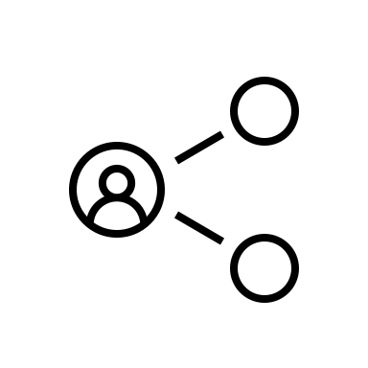


Load Balancing Benefits
Performance
Increase response time and reduce network latency
Distribute load evenly between servers to improve application performance
Redirect client requests to a geographically closer server to reduce latency
Ensure the reliability and performance of physical and virtual computing resources

Slide 98
Load Balancing
Both internet facing and private load balancers route requests to your targets using private IP addresses
Therefore, your resources don’t need public IP addresses
myapp.com
Load Balancer
App Server 1
App Server 3
10.0.0.7
App Server 2
10.0.0.9
10.0.0.8

Slide 99
Load Balancing Algorithms
Dynamic
Considers the state of each server and distribute traffic accordingly
Static
Distributes traffic using pre-defined rules

Slide 100
Load Balancing: Dynamic Algorithms
Least Connection
Checks which servers have the fewest connections open at the time and sends traffic to those servers. This assumes all connections require roughly equal processing power.
Weighted Least Connection
Gives administrators the ability to assign different weights to each server, assuming that some servers can handle more connections than others.
Weighted Response Time
Averages the response time of each server, and combines that with the number of connections each server has open to determine where to send traffic. By sending traffic to the servers with the quickest response time, the algorithm ensures faster service for users.
Resource-based
Distributes load based on what resources each server has available at the time. Specialized software (called an "agent") running on each server measures that server's available CPU and memory, and the load balancer queries the agent before distributing traffic to that server.
Least Response Time
The total time that the server takes to process the incoming requests and send a response. The least response time method combines the server response time and the active connections to determine the best server

Slide 101
Load Balancing: Static Algorithms
Round Robin
Distributes traffic to a list of servers in rotation using DNS. An authoritative nameserver will have a list of different A records for a domain and provides a different one in response to each DNS query.
Weighted Round Robin
Allows an administrator to assign different weights to each server. Servers deemed able to handle more traffic will receive slightly more. Weighting can be configured within DNS records
IP hash
Combines incoming traffic's source and destination IP addresses and uses a mathematical function to convert it into a hash. Based on the hash, the connection is assigned to a specific server.

Slide 102

Security Groups
Security groups are a software firewall placed around each attached network interface (NIC)
A security group is a collection of inbound and outbound rules that designate the port and protocols allowed into and out of each NIC
Operate at the EC2 instance level
Security groups are attached to a VM’s NIC
Primary EC2 NIC is eth0 (can have multiple)
Each NIC can be associated with up to 5 security groups
Security groups are associated with a VPC
NIC
EC2
HTTP
Security group
Subnet traffic
SSH

Slide 103
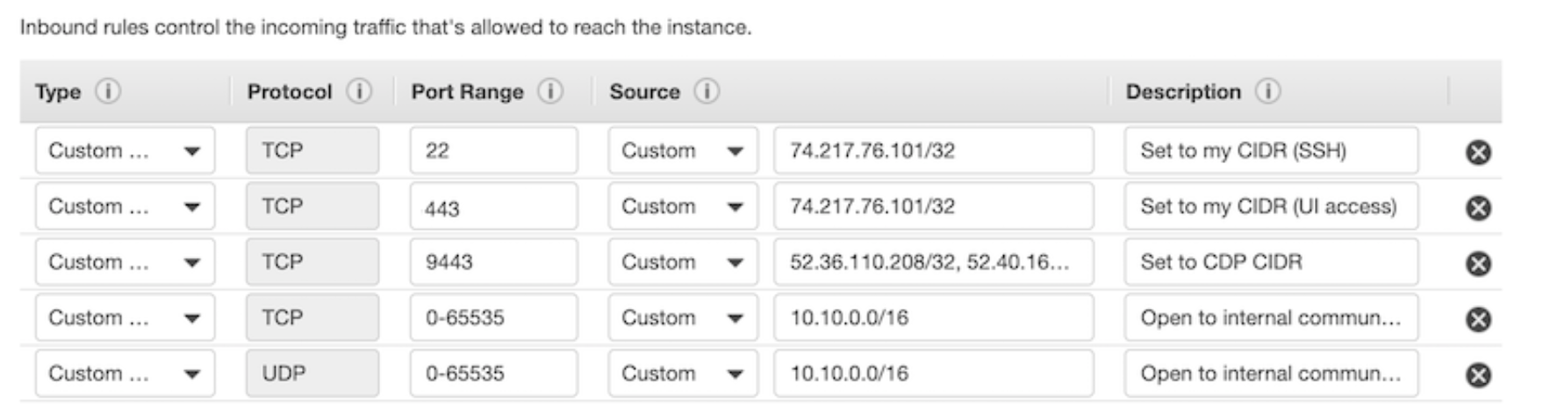
Security Groups
Inbound traffic is DENY by default
We set security group rules to ALLOW specified traffic
If access is not specifically allowed, it is implicitly denied
Outbound traffic is allowed by default when creating a new security group
Create the rules using the protocol, the port or port range, and the source inbound rules or destination outbound rules for the traffic

Slide 104
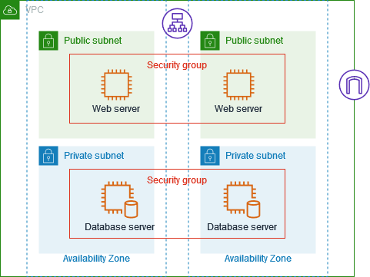
Security Groups
You can associate security groups with resources that perform the same function.
For example, you can associate all of your web servers with one security group and you database servers with a different security group.
Source: Wiz

Slide 105
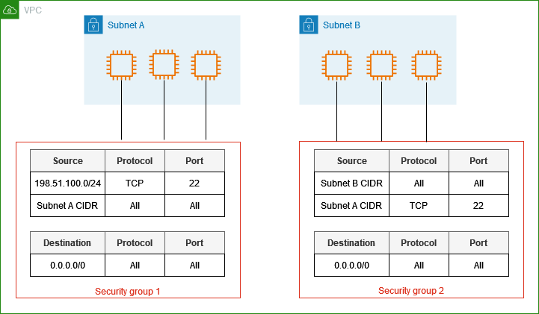
Security Groups
In this example, VMs in Subnet A allow inbound traffic from:
SSH connections from IPs in the 198.51.100.0/24 CIDR block
Traffic internal to the subnet
VMs in subnet B allow inbound traffic from:
Traffic internal to the subnet
SSH connections from Subnet A
All outbound traffic is allowed in each subnet.
Source: AWS Documentation

Slide 106
Security Groups
Defined as stateful; if requests are allowed in, the response traffic is allowed out regardless of the defined outbound rules.
However, an inbound port request does not necessarily use the same port number for outbound response
If a rule allows inbound HTTP on port 80, the outbound traffic response is allowed out, but the response traffic does not use port 80 outbound.
In most cases outbound traffic uses a dynamically assigned port called an ephemeral port (port is assigned by the underlying OS)

Slide 107
Security Group Best Practices
Restrict what ports need to be opened
If you place a load balancer in front of your EC2 instances, the only ports that need to be allowed by the security group protecting the load balancer are the port or ports your application requires.
Pick unique ports based on your production server’s tier placement
E.g. Web servers could be assigned port 3020
Application servers 3030
Database instances with custom ports chosen
Pick good names for your security groups!

Slide 108
Default Security Group
When you create a VPC, a default security group is created
Allows all outbound traffic between EC2 instances assigned the security group, however, any other traffic is implicitly denied.
Can’t delete it, but don’t have to use it.

Slide 109
Security Group Summary
Plan your security groups with names that make sense
Create security groups for administrative tasks
Create a security group for your public-facing load balancer that sends traffic to your web tier security group
Create a security group for your Web tier that sends traffic to your app tier or app tier load balancer security group
Create a security group for your app tier that sends traffic to your DB tier security group.
Deploy and test everything on a test VPC before deploying anything in production

Slide 110
Network ACLs
Controlling Subnet Traffic

Slide 111
Network access control lists
NACLs are an optional software firewall that controls inbound and outbound traffic for each subnet within the VPC
Each NACL contains a set of inbound and outbound subnet traffic rules
A custom NACL can be associated with any subnet
A subnet can only be associated with one ACL
Source: AWS

Slide 112
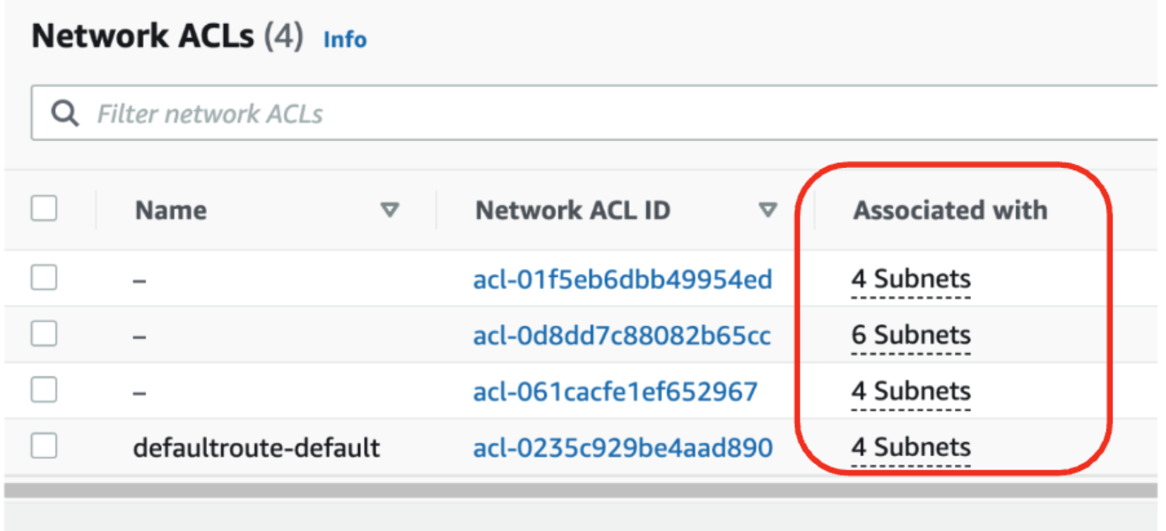
Network Access Control Lists
Each VPC has a default NACL
Allows all inbound and outbound IPv4 and IPv6 traffic at the subnet level
Source : Sysdig

Slide 113
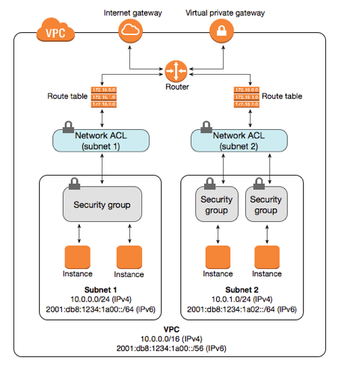
Network Access control lists
Why use NACLs if we have security groups?
ACLs operate at the lower subnet level and provide an additional layer of defense
A single NACL can protect multiple application servers at the subnet level
Rules can target an entire subnet or an individual IP
Make one NACL change and protect hundreds of instances rather than having to potentially change multiple security groups on each EC2 instance.

Slide 114
NACL Rules
Number in 10’s: 10 evaluated first, 20 second, etc.
Once a rule matches the traffic request, it’s applied, and no further rules are evaluated
Each rule must be defined as either ALLOW or DENY for the specified traffic
ACLs are stateless
Inbound and outbound rules are independent from each other
Return traffic from an instance in a VPC to a destination outside the VPC would be communicating using an ephemeral port.

Slide 115
Ephemeral Ports
TCP/IP communications don’t utilize the same inbound and outbound ports
The ephemeral port is a temporary port assigned by the OS TCP/IP stack
Port number is chosen by TCP/IP implementation based on host OS
Windows 2008 R2 and above: port range is 49152-65535
Linux: port range isn32768 to 61000
SSH: destination traffic always port 22, but return traffic from the server to client is from an ephemeral port

Slide 116
NACL + Ephemeral Ports
If custom NACLs are deployed, ephemeral rules need to appear in both the inbound and the outbound rules.
Outbound comms from an instance in a VPC needs to have an allowed outbound range of ephemeral ports
Each dynamically assigned port is released after the TCP connection terminates

Slide 117
NACL + Ephemeral Ports
Inbound Ports | Service | Protocol | Description | Outbound Port
20 | FTP | TCP/UDP | File Transfer Data | Dynamic
21 | FTP | TCP/UDP/ | File Transfer Control | Dynamic
22 | SSH | TCP/UDP/SCTP | Secure Shell | Dynamic
25 | SMTP | TCP/UDP | Simple Mail Transfer | Dynamic
67 | BOOTPS | UDP | Bootstrap (BOOTP/DHCP) Server | Dynamic
68 | BOOTPC | UDP | Bootstrap (BOOTP/DHCP) Client | Dynamic
69 | TFTP | UDP | Trivial File Transfer | Dynamic
80 | HTTP | TCP | Hypertext Transfer Protocol | Dynamic
In 88 | Kerberos | TCP | Kerberos | Dynamic
123 | NTP | UDP | Network Time Protocol | Dynamic
443 | HTTPS | TCP | HTTP protocol over TLS / SSL | 443
143 | Microsoft-ds | IMAP | Internet Message Access Protocol | Dynamic
Notes:
*Bootstrap protocol is used to automatically assign an IP address to network devices from a configuration server
Parts of BOOTP are used to provide service to the DHCP protocol.
*Kerberos is a protocol for authenticating service requests between trusted hosts across an untrusted network. Kerberos support is built in to all major computer OS.
Uses shared secret cryptography to prevent packets traveling across the network from being read or changed

Slide 118
Good Luck!!!

